Slide 1
Visual simulator for high quality planning domain models
Software Engineering 2: Project Teamwork Mälardalen University
Group #2
Client : Ericsson
Contact : Swarup Kumar Mohalik

Slide 2
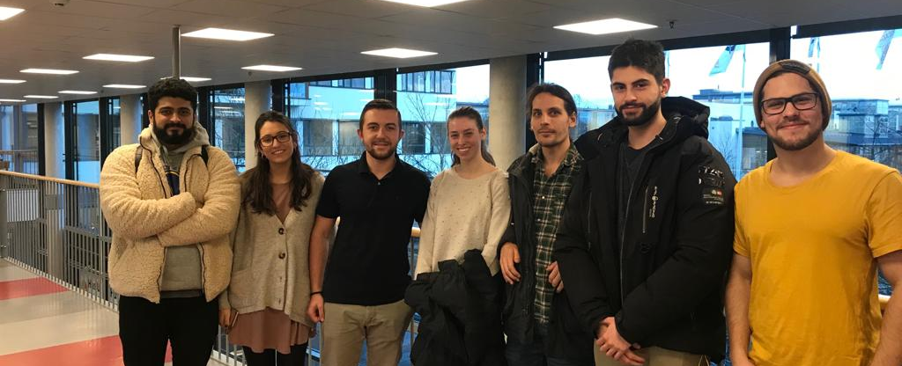
The Team

Slide 3




About Us

Slide 4
Responsibilities
Marta - Documentation & Report
Erik P - Presentation Overseer
Erik E - Conﬁguration Manager (Developer Studio)
Allan - Conﬁguration Manager (Trello)
Laura - Conﬁguration Manager (GIT)
Johannes - Client Contact
Ermal - Group Manager

Slide 5





Team communication and workflow

Slide 6
Meetings & Schedulehe
Monday
First group meeting
Wednesday
Meeting with the client
Friday
Second group meeting

